Slide 1
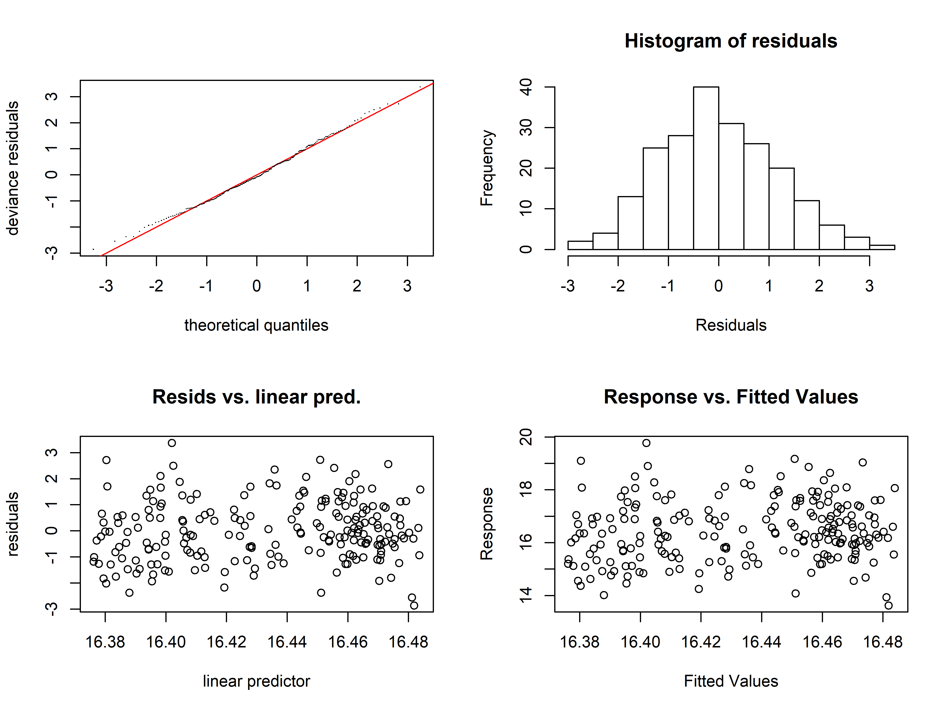
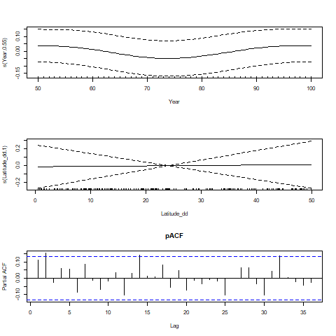
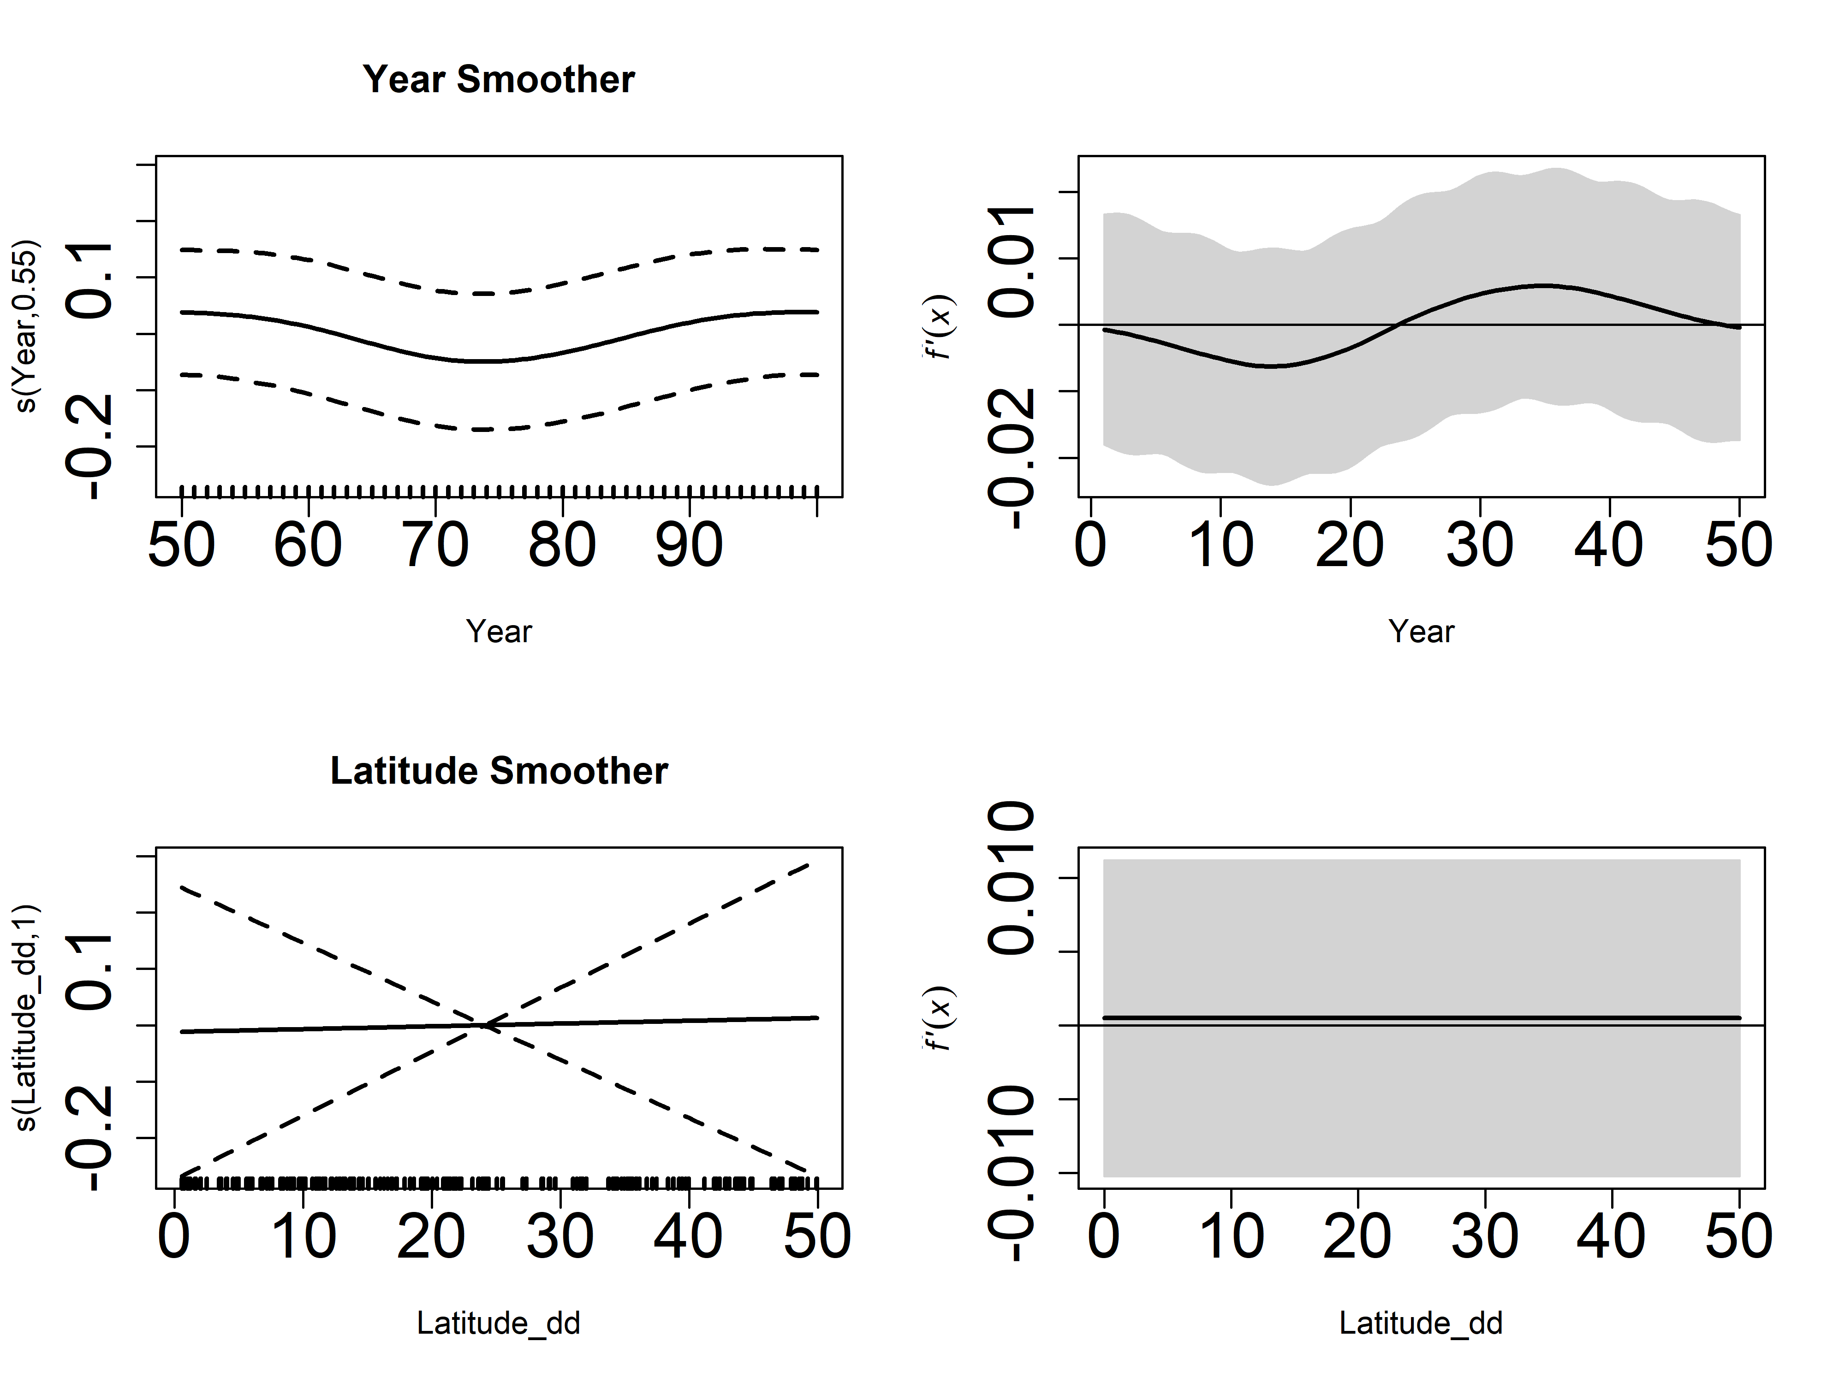
No breaks (temporal or spatial) – 31 Jan

Slide 2
No breaks (temporal or spatial) – 31 Jan

